Slide 1
Introduction to Software Engineering
Muhammad Kashif
CSSE3113

Slide 2
The Requirements Process
A requirement is an expression of desired behaviour
Requirements focus on the customer needs, not on the solution or implementation
  designate what behaviour, without saying how that behaviour will be realized

Slide 3
The Requirements Process
Sidebar: Why Are Requirements Important?
Top factors that caused project to fail
  Incomplete requirements
  Lack of user involvement
  Unrealistic expectations
  Lack of executive support
  Changing requirements and specifications
  Lack of planning
  System no longer needed
Some part of the requirements process is involved in all of the causes
Requirements error can be expensive if not detected early

Slide 4
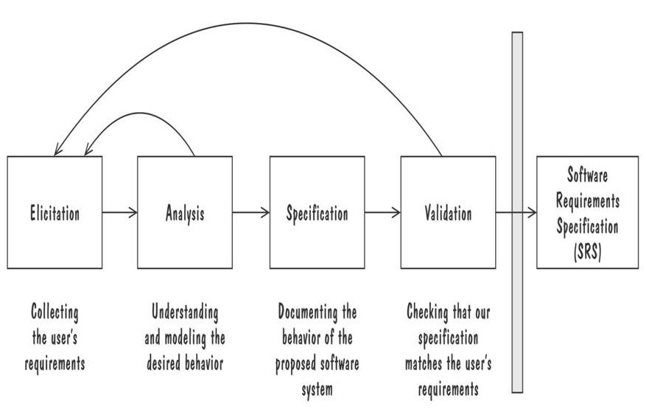
The Requirements Process
Performed by the req. analyst or system analyst
The final outcome is a Software Requirements Specification (SRS) document
Process for Capturing Requirements

Slide 5
Requirements Elicitation
Customers do not always understand what their needs and problems are
It is important to discuss the requirements with everyone who has a stake in the system
Come up with agreement on what the requirements are
  If we cannot agree on what the requirements are, then the project is doomed to fail

Slide 6
Requirements Elicitation
Different Stakeholders are:
  Clients: pay for the software to be developed
  Customers: buy the software after it is developed
  Users: use the system
  Domain experts: familiar with the problem that the software must automate
  Market Researchers: conduct surveys to determine future trends and potential customers
  Lawyers or auditors: familiar with government, safety, or legal requirements
  Software engineers or other technology experts

Slide 7
Requirements Elicitation
Sidebar: Using Viewpoints to Manage Inconsistency
No need to resolve inconsistencies early in the requirements process (Easterbrook and Nuseibah, 1996)
Stakeholders' views documented and maintained as separate Viewpoints through the software development process
  The requirements analyst defines consistency rules that should apply between Viewpoints
  The Viewpoints are analyzed to see if they conform to the consistency requirements
Inconsistencies are highlighted but not addressed until there is sufficient information to make informed decision

Slide 8
Requirements Elicitation
Means to Elicit Requirements:
  Interviewing stake holders
  Reviewing available documentations
  Observing the current system (if one exists)
  Apprenticing with users to learn about user's task in more details
  Interviewing user or stakeholders in groups
  Using domain specific strategies, such as Joint Application Design, or PIECES
  Brainstorming with current and potential users

Slide 9
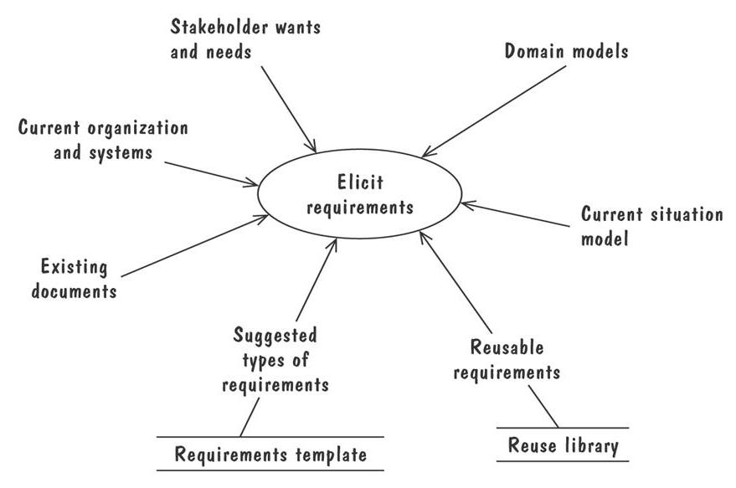
Requirements Elicitation
The Volere requirements process model suggests some additional sources for requirements

Slide 10
Types of Requirements
Functional requirement
  Describes: interaction between the system and its environment, how should the system behave given certain stimuli, required behaviour in terms of required activities
  Example: For a system of printing pay cheques the functional requirements must answer the following:
    When are pay cheques issued?
    What input is necessary for a pay cheque to be printed?
Quality requirement or non-functional requirement
  Describes: some quality characteristic that the software must posses, a restriction on the system that limits our choices for constructing a solution
    Constraints could be:
      Design constraint: a design decision such as choice of platform or interface components
      Process constraint: a restriction on the techniques or resources that can be used to build the system
  Example: queries to the system must be answered within 3 seconds
Both types of requirements are elicited from the customer in a formal, careful way.

Slide 11
Types of Requirements
Two kinds of Requirement Documents
  Requirements definition: a complete listing of everything the customer wants to achieve
    Describing the entities in the environment where the system will be installed
  Requirements specification: restates the requirements as a specification of how the proposed system shall behave
    Primarily used by our technical team

Slide 12
Prioritizing Requirements
Different stakeholder has different set of requirements
  potential conflicting ideas
Need to prioritize requirements to resolve conflicts
Prioritization might separate requirements into three categories
  essential: absolutely must be met
  desirable: highly desirable but not necessary
  optional: possible but could be eliminated

Slide 13
Lecture

Slide 14
Characteristics of Requirements
Correct
Consistent
Unambiguous
Complete
Feasible
Relevant
Testable
Traceable

Slide 15
Testable Requirements
Testable/Measurable Requirement:
  Objective description of the requirement’s meanings
  All possible entities and activities can be examined and classified as Meet Requirements and Do Not Meet Requirements
Testable requirements are helpful in making good design
Requirements that are not testable are likely to be ambiguous, incomplete and incorrect

Slide 16
Testable Requirements
Robertson and Robertson suggest 3 ways to help make requirements testable:
  Specify a quantitative description for each adverb and adjective
  Replace pronouns with specific names of entities
  Make sure that every noun is defined in exactly one place in the requirements document

Slide 17
Testable Requirements
Some examples:
  Not Testable: Water quality information must be accessible immediately
  Testable: Water quality information must be retrieved within five seconds of request
  Not Testable: The system should handle a large number of users at a time
  Testable: The system should handle 5000 users at a time
  Not Testable: User should press the Save button when writing text in the system. This prevents it from being lost.
  Testable: User should press the Save button when writing a note in the system. Pressing the Save button prevents the text from being lost.

Slide 18
Expressing Requirements
A requirement deals with
    objects or entities
    the state they can be in
    functions that are performed to change states or object characteristics
It is important to have standard notations for modelling, documenting, and communicating decisions
Modelling helps us to understand requirements thoroughly
  Holes in the models reveal unknown or ambiguous behaviour
  Multiple, conflicting outputs to the same input reveal inconsistencies in the requirements

Slide 19
Expressing Requirements
Dynamic Descriptions of a System
  Decision Tables
  State Diagrams (Statecharts)
  Fence Diagrams
  Event Tables
  Petri Nets
  Event Traces (Message Sequence Charts)
Static Descriptions of a System
  Object Models (ER Diagrams, Abstract class diagrams)
Other Techniques to Express Requirements
  Data Flow Diagrams (DFD)
  Usecase Diagrams

Slide 20
Decision Tables
It is a tabular representation of a functional specification that maps events and conditions to appropriate reponses or action
The specification is formal because the inputs (events and conditions) and outputs (actions) may be expressed in natural language
If there is n input conditions, there are 2^{n} possible combination of input conditions
Combinations map to the same set of result can be combined into a single column

Slide 21
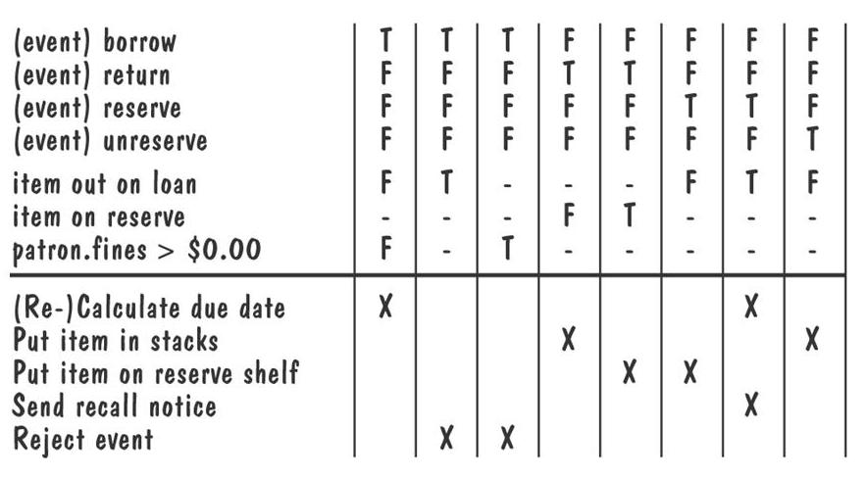
Decision Tables (Contd.)
Decision table for library functions borrow, return, reserve, and unreserve

Slide 22
State Diagrams
A graphical description of all dialog between the system and its environment
  Node (state) represents a stable set of conditions that exists between event occurences
  Edge (transition) represents a change in behavior or condition due to the occurrence of an event
Useful both for specifying dynamic behavior and for describing how behavior should change in response to the history of events that have already occurred

Slide 23
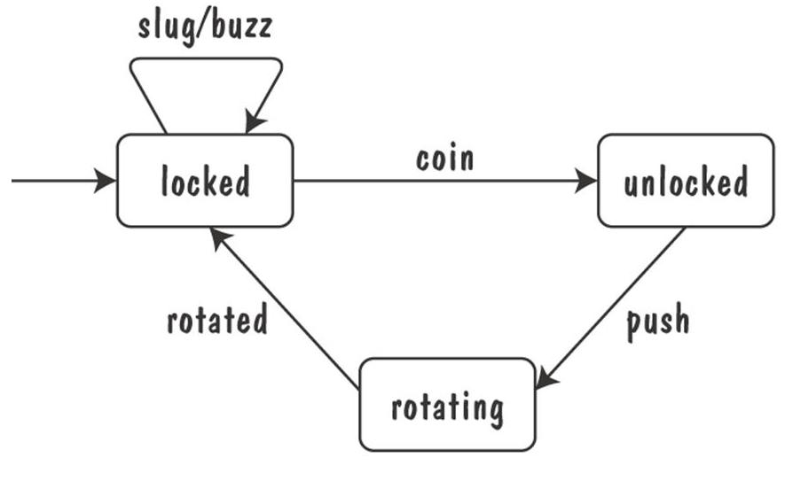
State Diagrams (Contd.)
Finite state machine model of the tunstile problem

Slide 24
State Diagrams (Contd.)
A path: starting from the machine's initial state and following transitions from state to state
  A trace of observable events in the environment
Deterministic state machine: for every state and event there is a unique response

Slide 25
State Diagrams (Contd.)
Ways of thinking about State
  Equivalence classes of possible future behavior
  Periods of time between consecutive event
  Named control points in an object's evolution
  Partition of an object's behavior

Slide 26
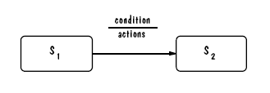
State Diagrams: UML Notation

Slide 27
State Diagrams: UML Statechart
A UML statechart diagram depicts the dynamic behaviour of the objects in a UML class
  UML class diagram has no information about how the entities behave, how the behaviours change
A UML model is a collection of concurrently executing statecharts
UML statechart diagram have a rich syntax, including state hierarchy, concurrency, and inter-machine communication

Slide 28
UML Statechart Diagram
State hierarchy is used to unclutter diagrams by collecting into superstate those states with common transitions
A superstate can actually comprise multiple concurrent submachines, separated by dashed line
  The submachines are said to operate concurrently
Students can recall the activity of reducing a DFA, or converting a DFA to a RE during Automata Course

Slide 29
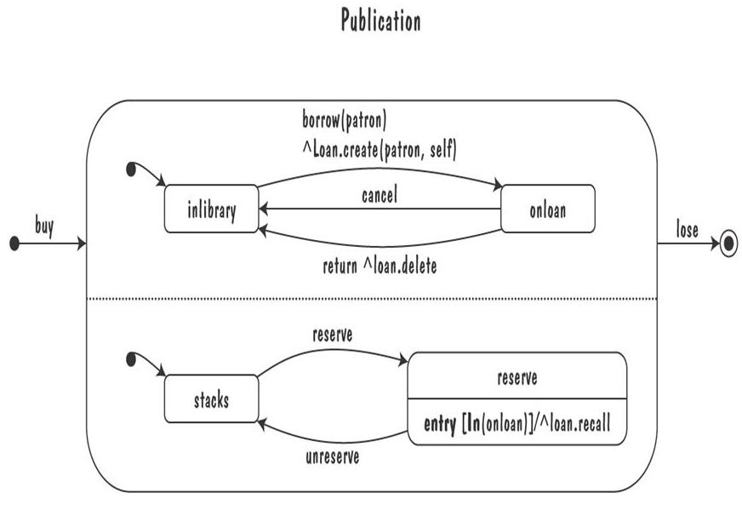
UML Statechart Diagram
The UML statechart diagram for the Publication class from the Library class model

Slide 30
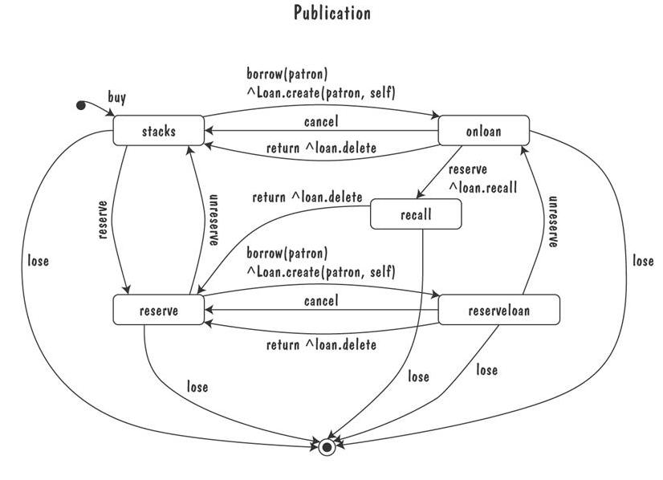
UML Statechart Diagram
An equivalent statechart for Publication class that does not make use of state hierarchy or concurrency
  comparatively messy and and repetitive

Slide 31
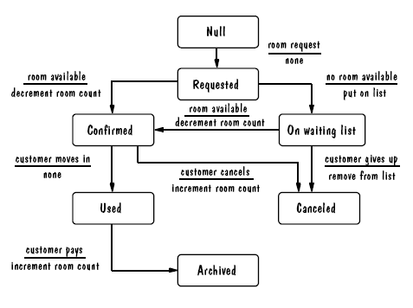
UML Statechart Diagram Example
The UML state diagram for Hotel Reservation

Slide 32
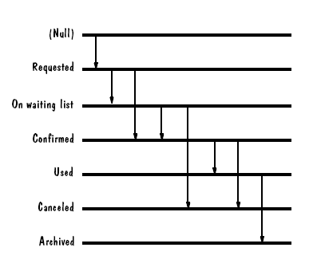
Fence Diagram

Slide 33
Special THANK FOR THE MATERIALS
Mr. Haroon Abdul Waheed
Prof. Zeeshan Ali Rana
Pfleeger’s Book slides from UCF
Software Fundamentals

